Slide 1
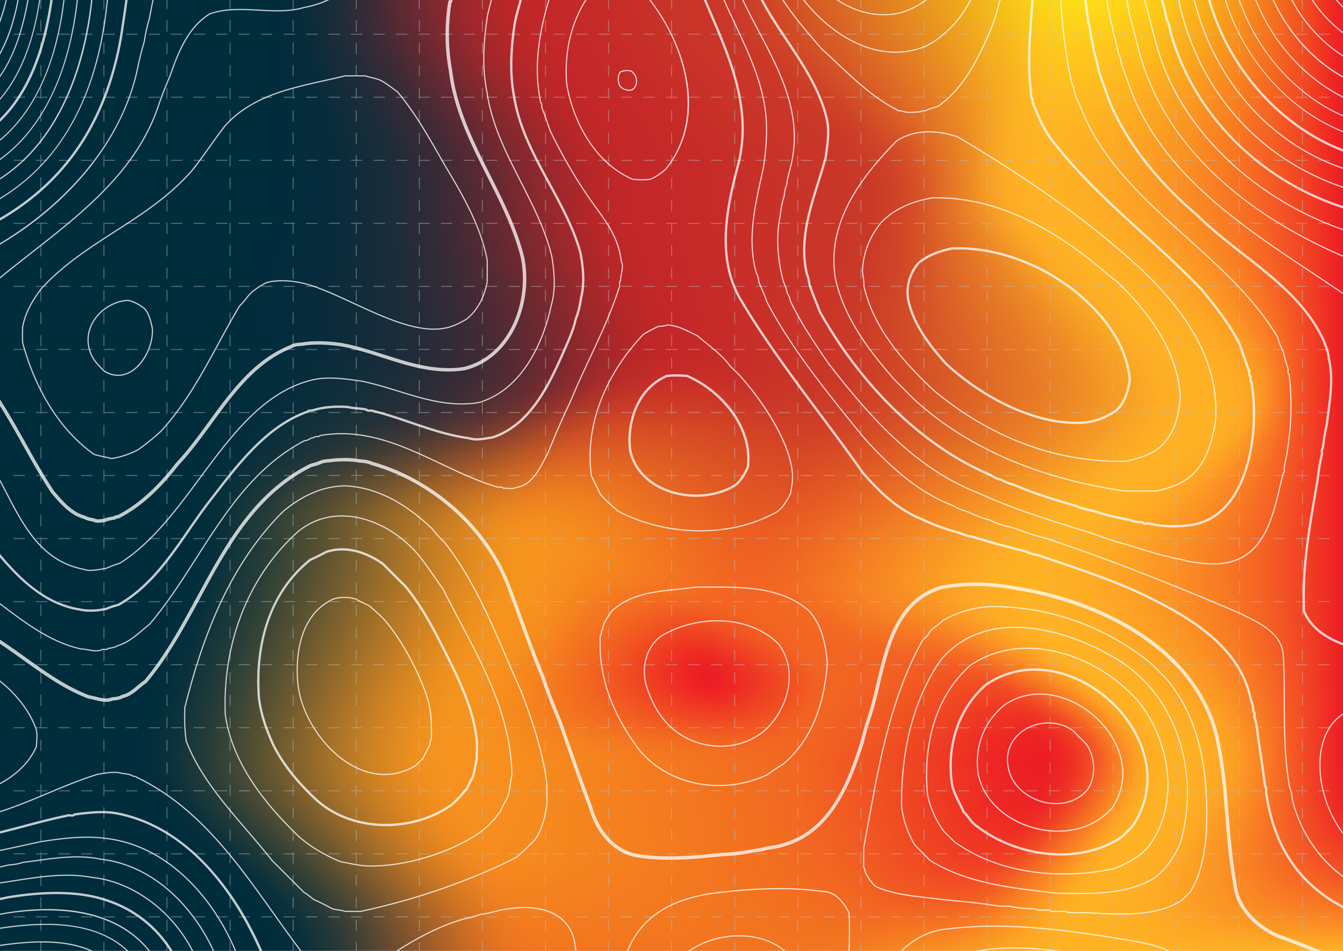
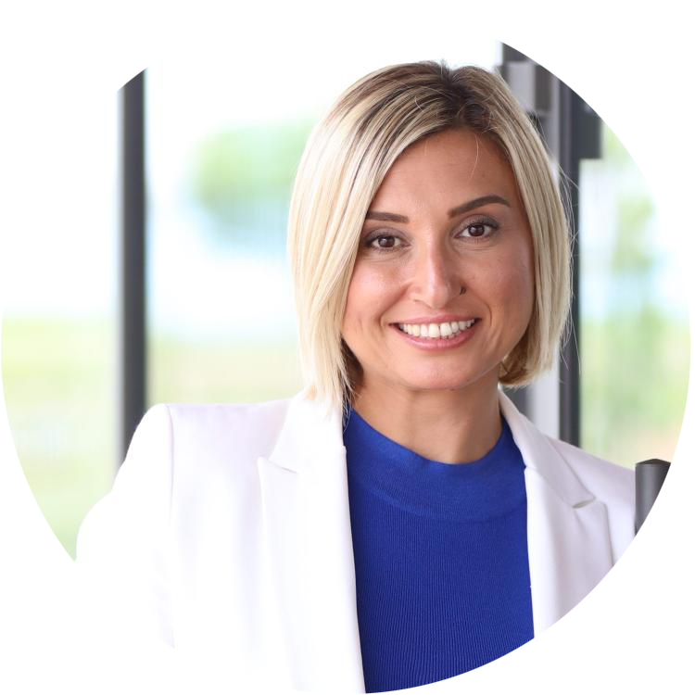

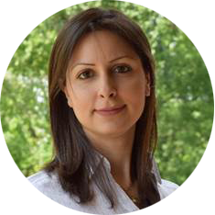




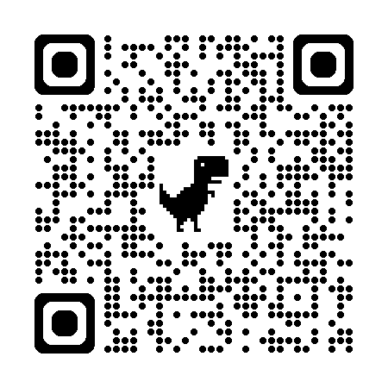


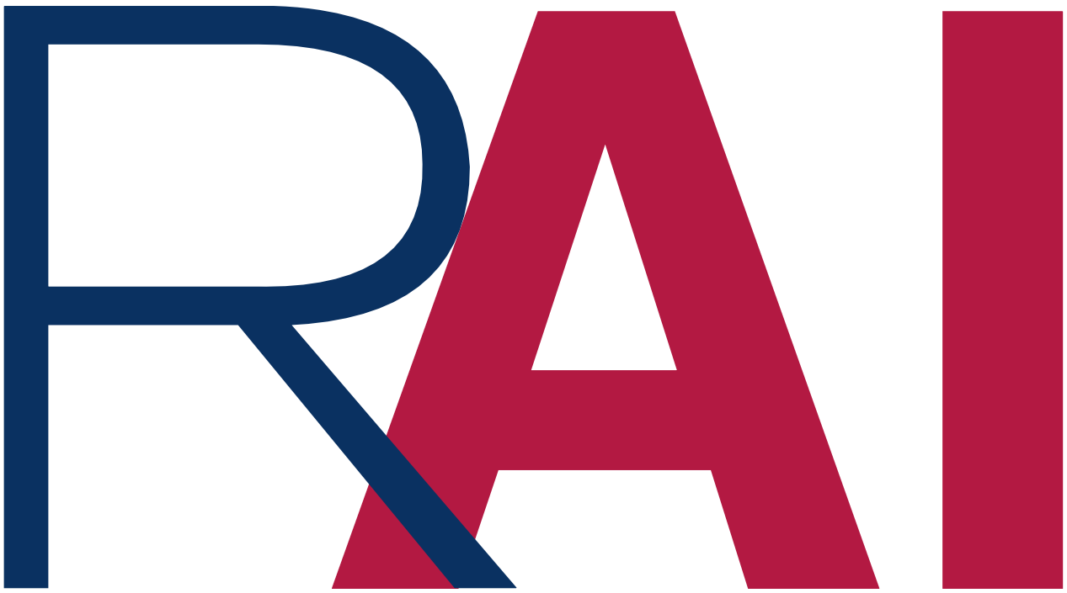
THE 1st NORTH FLORIDA
WILDFIRE SCIENCE & TECHNOLOGY WORKSHOP
Bridging Prediction, Infrastructure and Decision-Making
Friday, March 13th, 2026
10:00 AM – 05:00 PM (ET)
LOCATION: Tallahassee
1729 W. Paul Dirac Drive, Tallahassee, FL 32310
Dr. Ilkay Altintas
San Diego Supercompter Center
Dr. Xilei Zhao
University of Florida
Dr. Neda Yaghoobian
Florida State University
Dr. Who
To be Determined
FEATURED SPEAKERS
CORE THEMES
I. Prediction & Modeling: Spatial-Temporal AI for Fire Behavior & Risk.
II. Wildfire Data & Resources:
Datasets, Challenges, and Reliable Pipelines
II. Infrastructure & Operations: Scalable Systems for Real-Time Response
IV. Decision-Making: Translating Models into Practical Impact
ABOUT THE WORKSHOP
An interdisciplinary gathering of researchers and practitioners in AI, remote sensing, data mining, and wildfire science to build the next-generation wildfire solution for North Florida and beyond.
Join us for: Invited Talks | Expert Panels | Student Presentations
For inquiries: Yushun Dong (yushun.dong@fsu.edu)
Website: https://labrai.github.io/WildFireWorkshop/

Slide 2
